Slide 1
Special Notes
Dear colleagues,
You know that a sentences may be completed in different ways, So to understand the full meaning of the sentence, students have to write the question on the answer script and then they will complete it. Completed part must be underlined. Only answer should not be written in the answer script. It is wrong. It is notable that after completing all the sentences , it will express a complete sense of an event or a topic because all the grammar items are now a days contextual. Necessary notes are given below the slide . Please follow it before going to present it in the class.
Your near and dear
Md. Hasan Hafizur Rahman
Cambrian School & College
Dhaka
Notes:
This option is very imporant. If you want to make the class fruitful, please follow the instructions in this option carefully before present it in the class.

Slide 2
Welcome
Notes:
Welcome slide.

Slide 3
Introduction
Md. Hasan Hafizur Rahman
Lecturer and Head of the Department (English)
Cambrian School & College
Baridhara, Dhaka
Presentation made for
Class IX-X
English 2nd paper
Grammar
Notes:
Introduction of the teacher and the class.

Slide 4
because of his illness.
He could not go to college______________________
What kind of sentence is this?
Completing sentence
Let us discuss about completing sentence.
Notes:
Suspension and lesson declaration.

Slide 5
Learning outcomes
At the end of the lesson , we will be able to –
identify some items of completing sentence
identify the formation of completing sentence
complete incomplete sentences
Notes:
The above outcomes will be achieved from this content.

Slide 6
Completing item -13
Use of because of, on account of, owing to & due to’.
on account of his illness
He cannot do hard job______________________.
Complete the following sentences.
1. Everybody loves him___________.
2. On account of rain_____________.
3. __________________due to thick fog.
Notes:
Because of/on account of/due to/owing to এর বাংলা অর্থ ‘কারনে / জন্যে ‘

Slide 7
Completing item -14
Use of ‘would rather……………..than’.
coffee.
I would rather drink tea than_______
Complete the following sentences.
1. I would rather die than___________.
2. I would rather go _____________.
3. ___________ than fail.
Notes:
Would rathmer means বরং... তবুও

Slide 8
Completing item -15
Use of ‘had better’
(বরং ভাল)
You had better___
go
Had better. It is unreal past. It does not mean past tense rather it
denotes present and future. No infinitive is used after it.
Complete the sentences
1. I had better __________________
2. He had better________________
3. They had better______________
4. You had better_______________
Notes:
It does not mean past tense rather it is present tense. Had better দ্বারা past tense বুঝায় না বরং এটি present tense নির্দেশ করে।

Slide 9
Completing item -16
Formation: No sooner had + subject
+v₃ + extension + than + subject + v₂
Use of ‘No sooner…..than’.
No sooner had he reached the station________________.
than the train left.
Notes:
শিক্ষার্থীরা অনেক সময় than এর জায়গায় then লিখে ফেলে। বিষয়টি তাদের ভালভাবে বুঝিয়ে দেওয়া দরকার।

Slide 10
Activities
No sooner had the police come________________________________
No sooner had the bell rung_______________________________________
________________________ we started for home.
No sooner had the magic started_______________________________________
________________________________than the play began.
Notes:
It is for feed back.

Slide 11
Completing item -17
Use of ‘It is time (proper time)’
Formation-1: It is time to + v₁ + extension
It is time to
start the plane.
Formation-2: It is time for +object+ to + v₁ + extension
It is time for me to
board the plane.
Notes:
To mean proper time all will be present tense. (যথাযথ সময় বুঝাতে sentences এর উভয় অংশে present tense হবে)

Slide 12
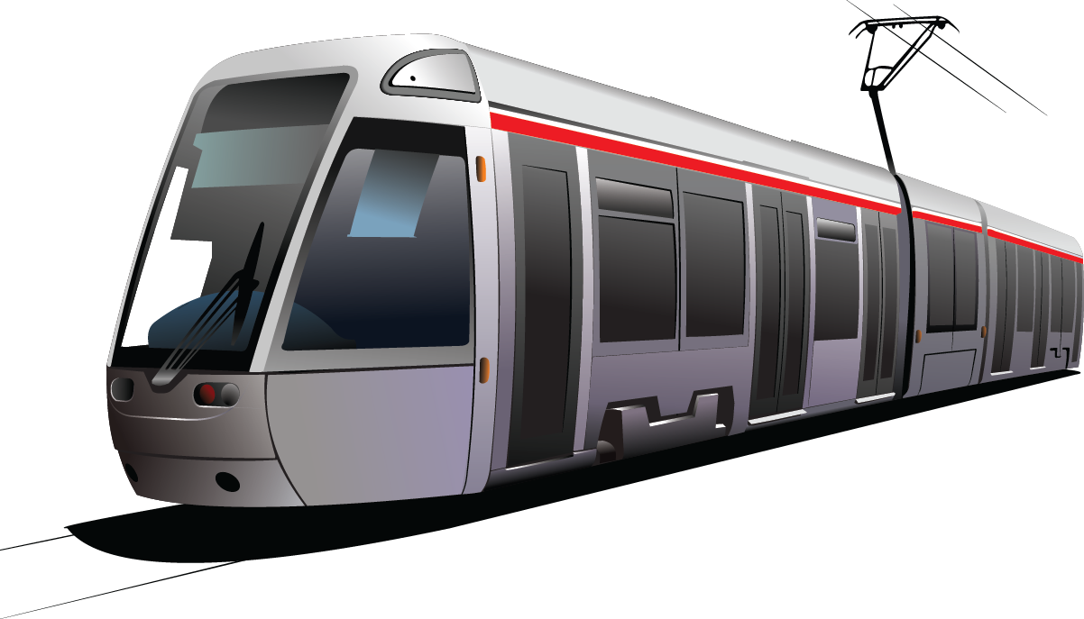
Completing item -18
Use of ‘It is time (Time is over)’
Formation-1: It is time +Subject + v₂ + extension
It is time we
started the train journey.
Notes:
To mean passed time last one will be past tense. (সময় অতিক্রান্ত হয়েছে বুঝাতে প্রথম অংশ present tense হবে, পরের অংশ past tense হবে।)

Slide 13
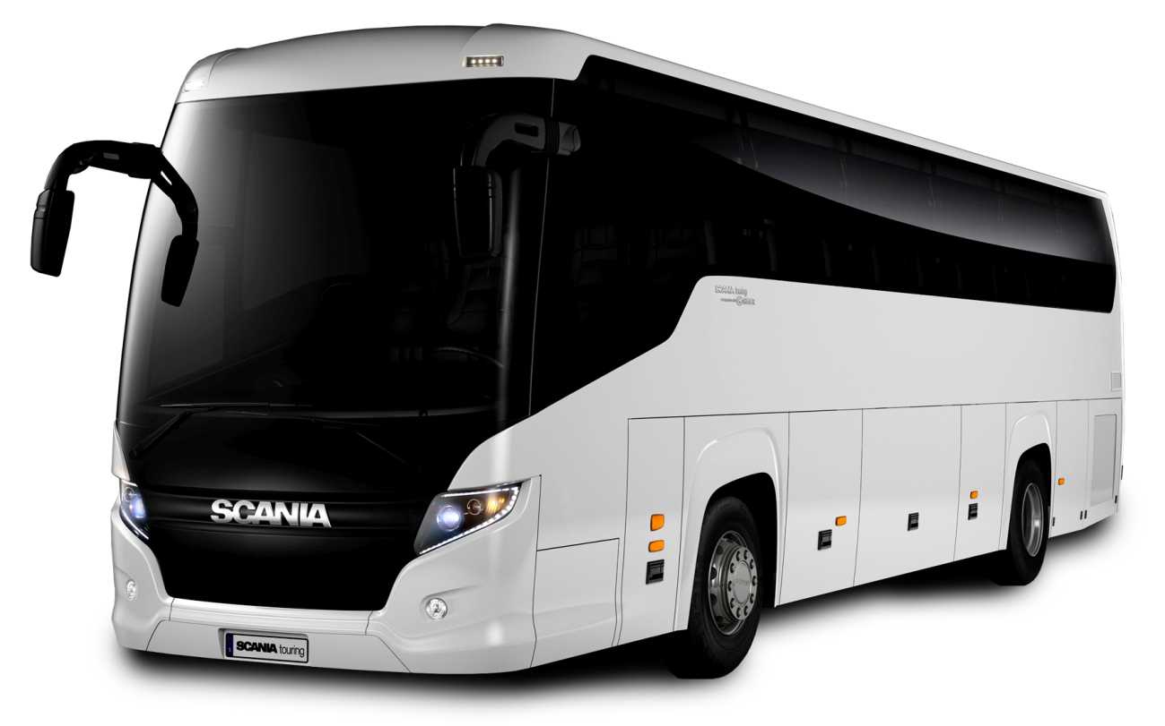
Completing item -19
Use of ‘It is high time (Time is over)’
Formation-1: It is high time +Subject + v₂ + extension
It is high time we
started journey by bus.
Notes:
জোর দিয়ে বুঝাতে high time ব্যবহৃত হয়। Subject এর পরে verbটি past হলেও মূলতঃ এটি present tense এর অর্থ প্রকাশ করে।

Slide 14
Activities
It is time________________________________
_____________________we started our duty.
It is high time________________________.
__________________________we started our prayer.
It is time___________________
It is time for us_____________________
Notes:
Feed back/ Evaluation.

Slide 15
Completing item -20
Use of ‘As if/As though
Formation-1: Sub + v₁ + extension + as if/as though+ sub +v₂+extension.
He speaks as though
he knew everything.
Formation-2: Sub + v₂ + extension + as if/as though+ sub +had+v₃+extension.
He spoke as though
he had known everything.
Notes:
It the first sentence is present tense, 2nd will be past and if the first sentence is past tense , 2nd will be past perfect tense.

Slide 16
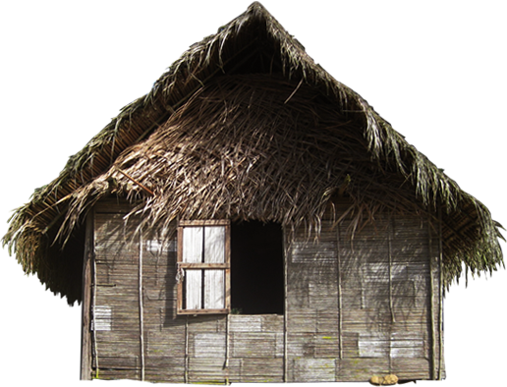
Completing item -21
Use of ‘Let alone(Undesirable thinking)’
Formation : Negative sentence +let alone + relevant part of the sentence
He cannot live in a hut let alone
an aristocratic house.
Notes:
“চিন্তা করা যায় না/ভাবা যায় না” অর্থ প্রকাশ করতে Let alone ব্যবহৃত হয়। ইহা সাধারণতঃ Negative অর্থ প্রকাশ করে।

Slide 17
Activities
He can not eat a mango let alone_______________
_____________________ten kilometers.
They can not play so bad let alone________________________.
__________________________GPA 5.
She can not cook rice let alone___________________
Notes:
Feed back/ Evaluation.

Slide 18
Continue to next content
Notes:
Ending slide.

